Slide 1
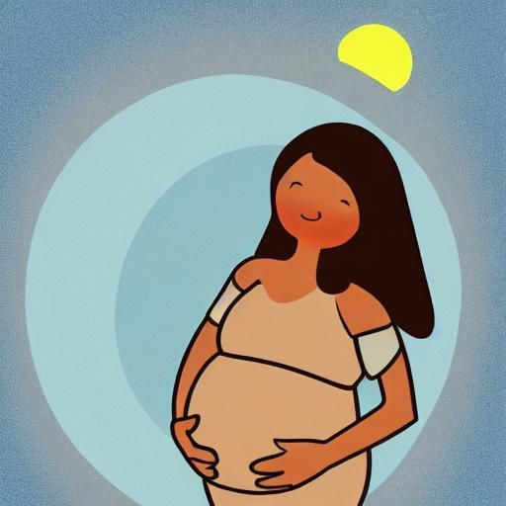



Luna
Health for the Whole Family
How to use this app
Start learning
Notes:
- Framework developed from WHO guidelines and adapted for CNB Panama context:
9789241549912-eng.pdf (who.int)
- All images are public domain/creative commons, source is noted
Image source
Nightcafe
2,3. Pixabay

Slide 2
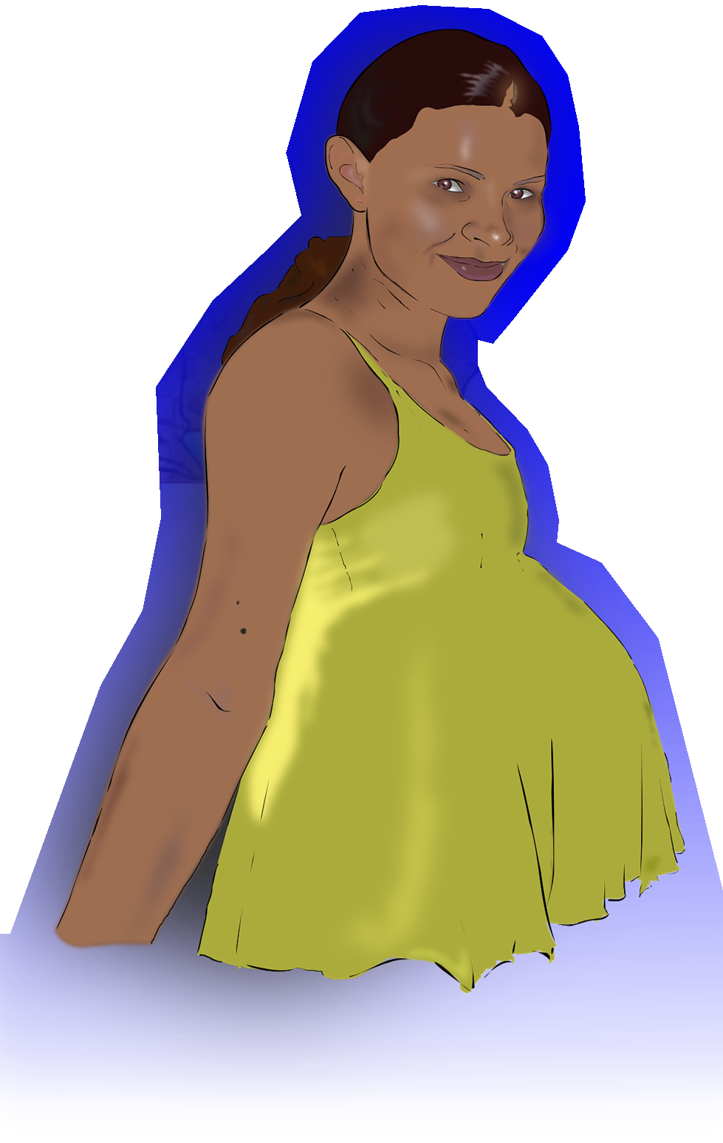
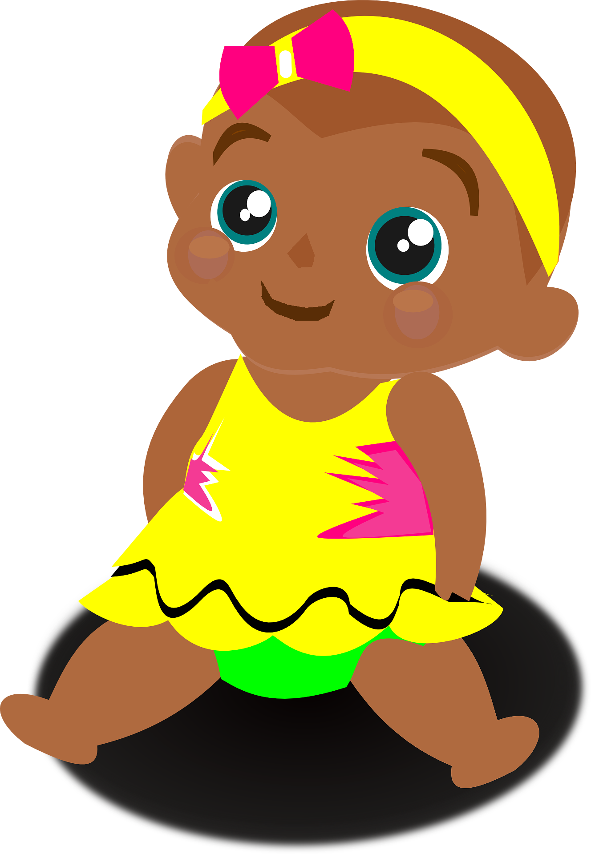
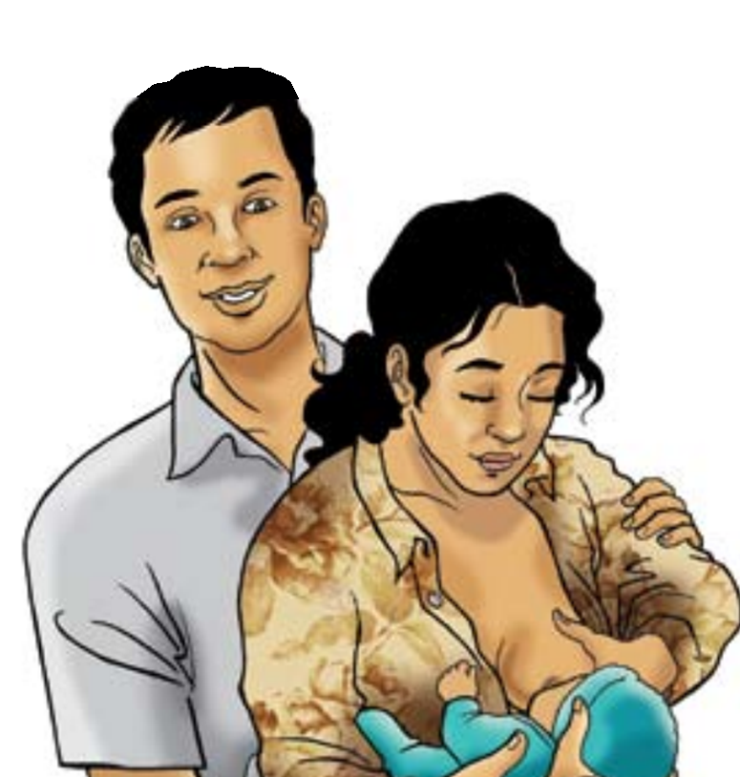

My topics
Pregnancy Health
Children’s Health
Reproductive
Health
Download
new topics
Notes:
Image source
1. Download Pregnant, Woman, Pregnancy. Royalty-Free Vector Graphic - Pixabay
2,4. Pixabay
3. Indonesia C-IYCF Counselling Cards (ptiib.s3.amazonaws.com)

Slide 3

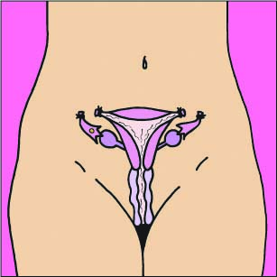
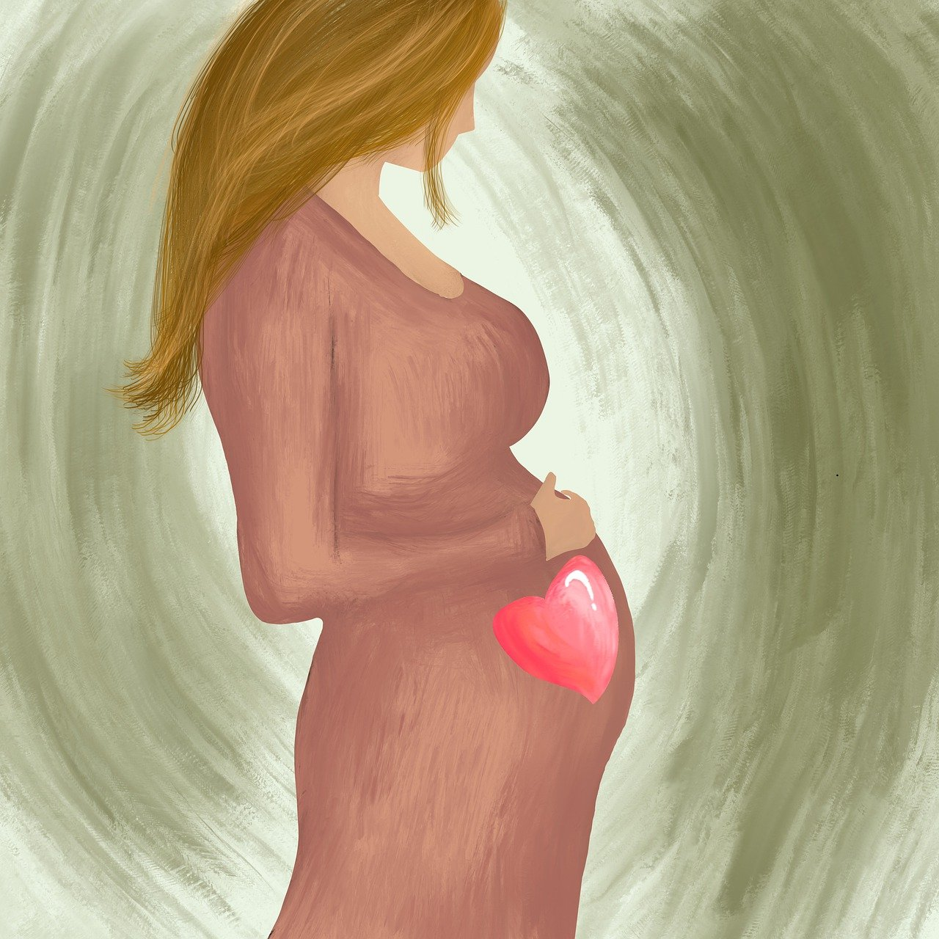
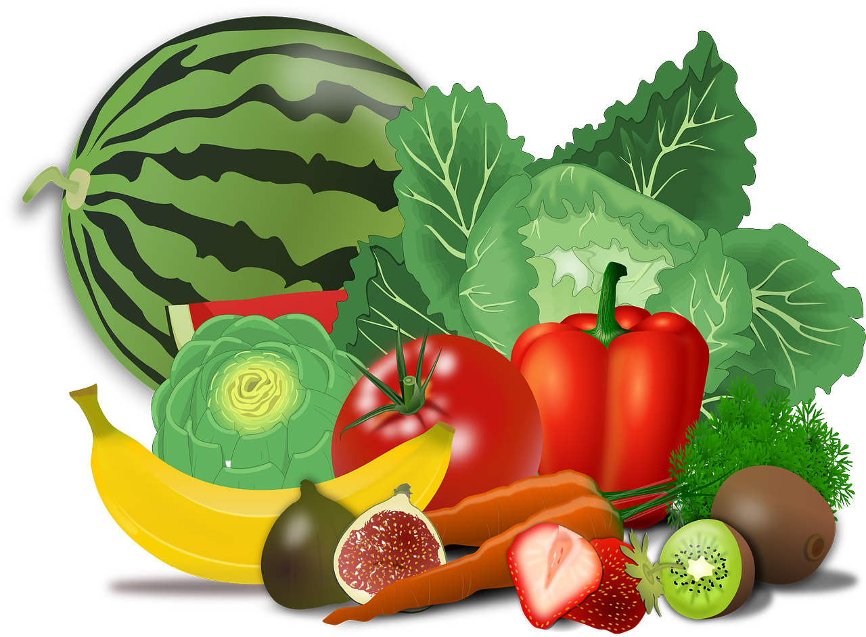
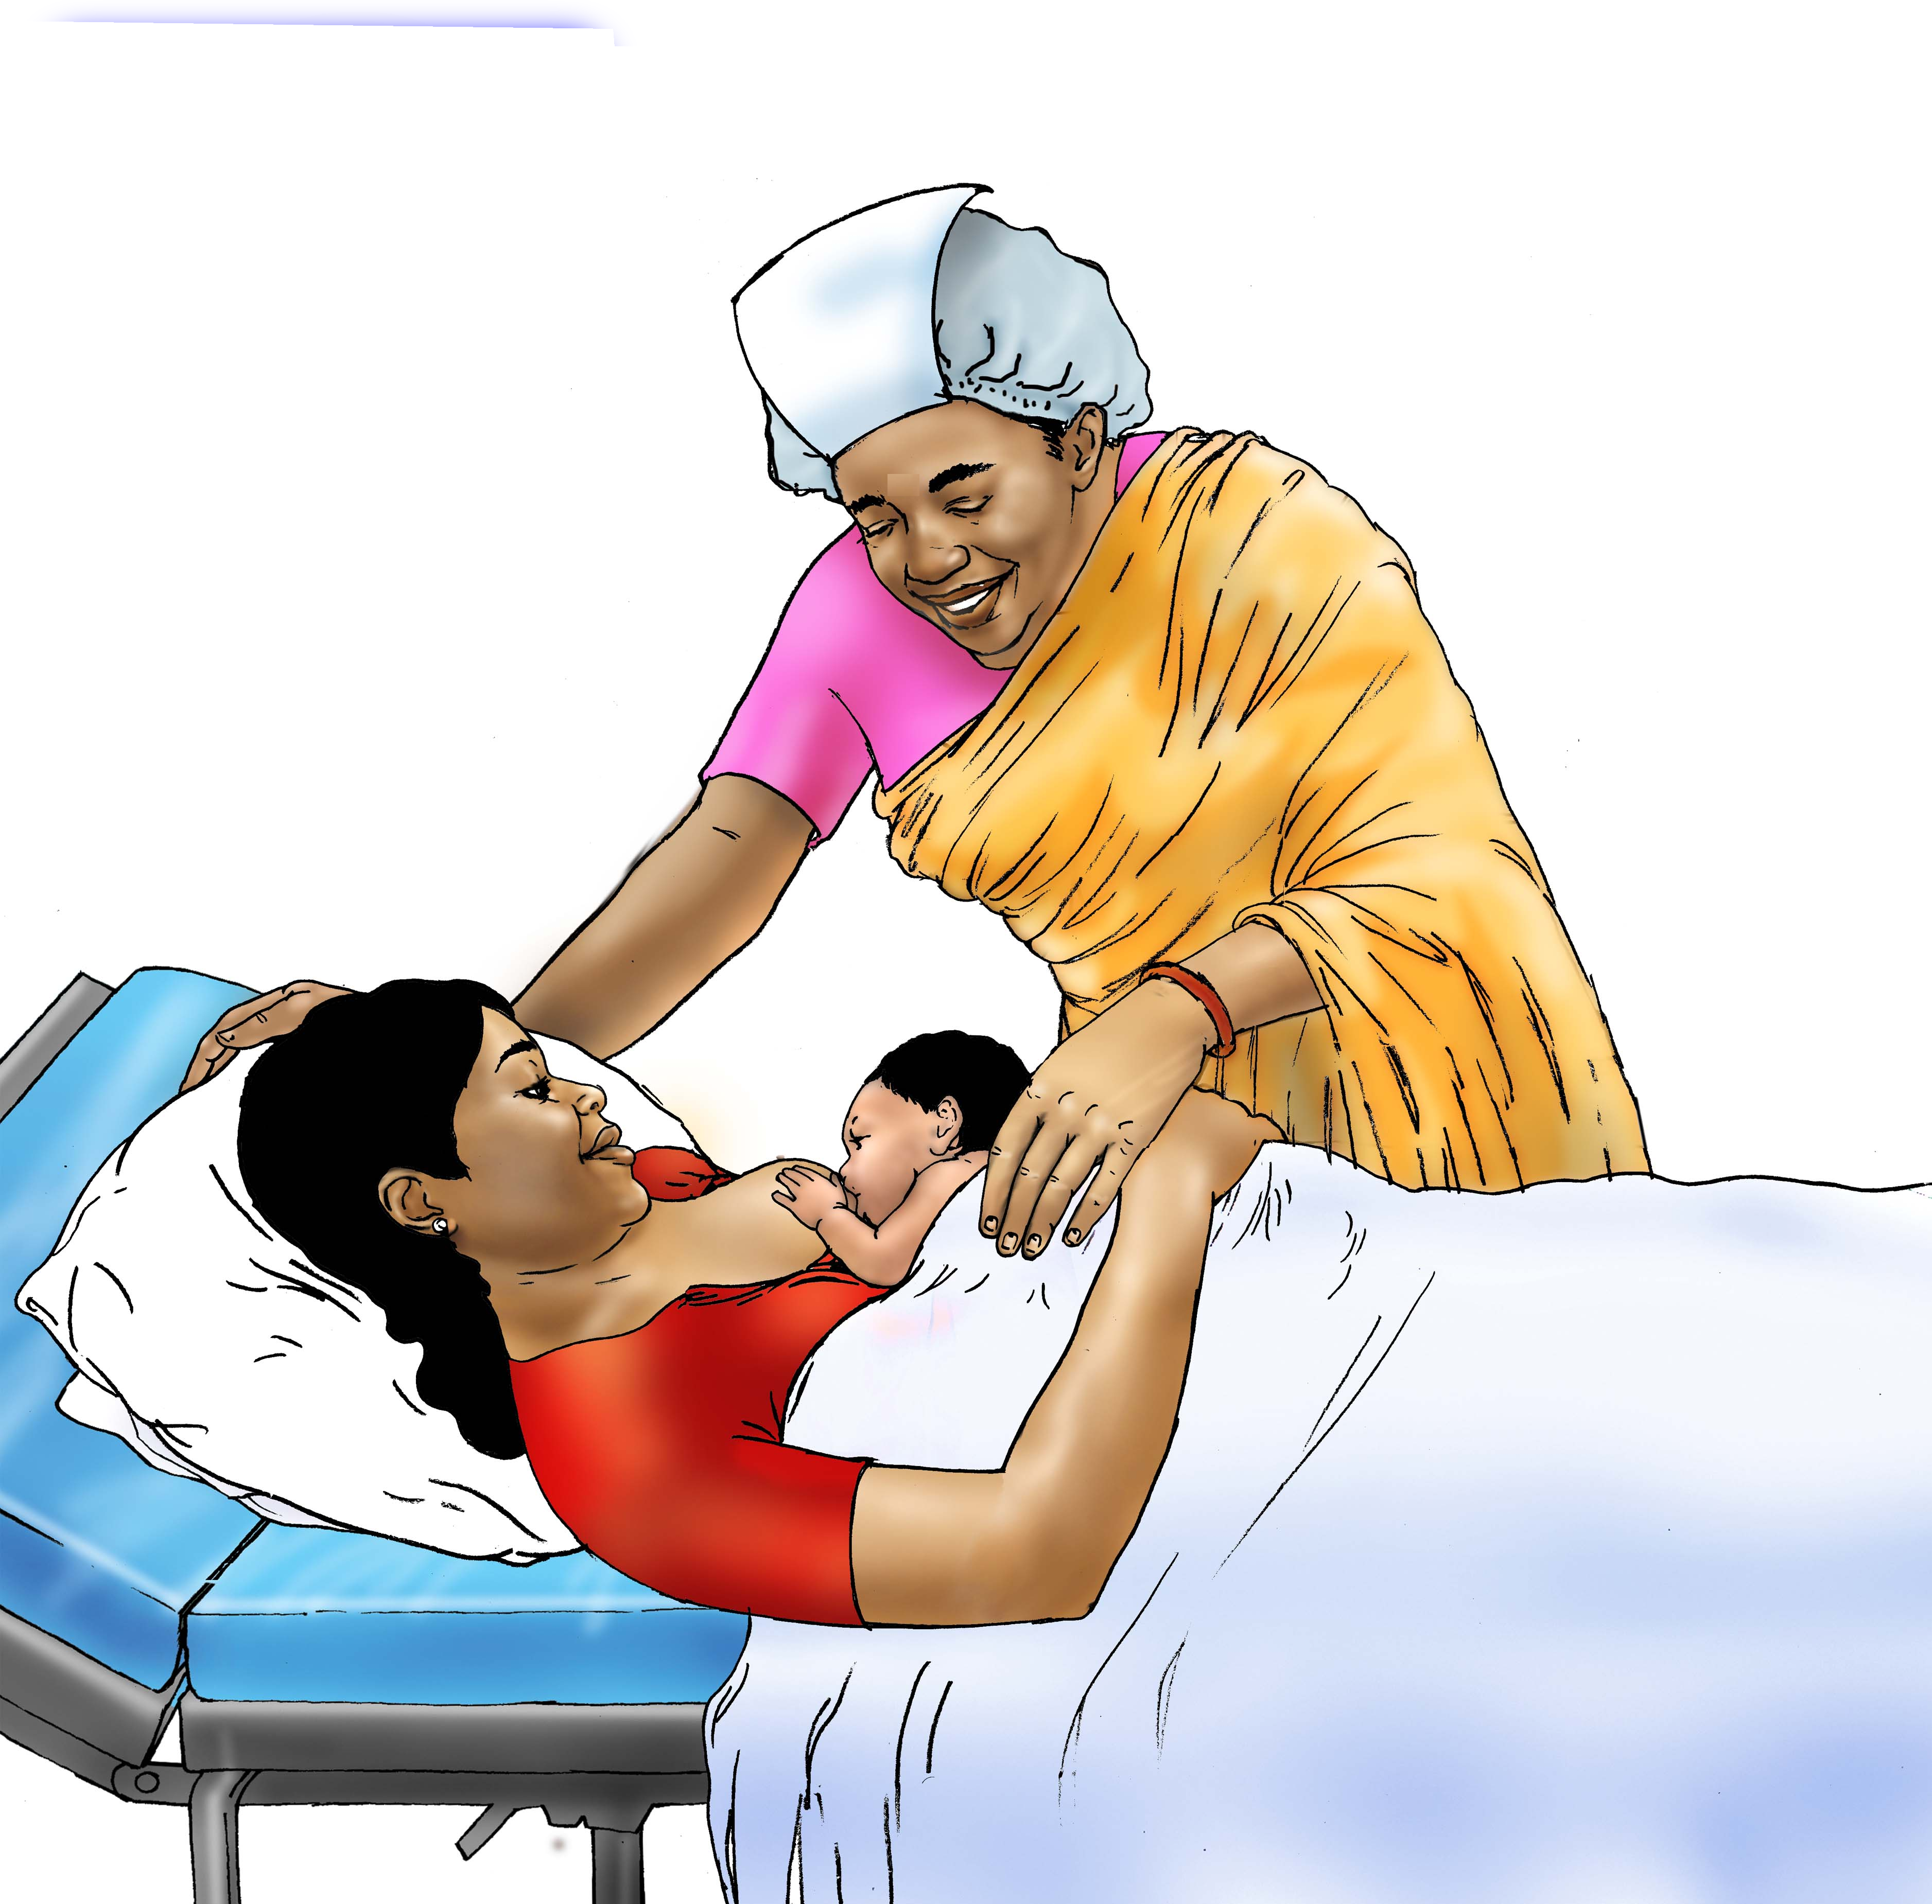
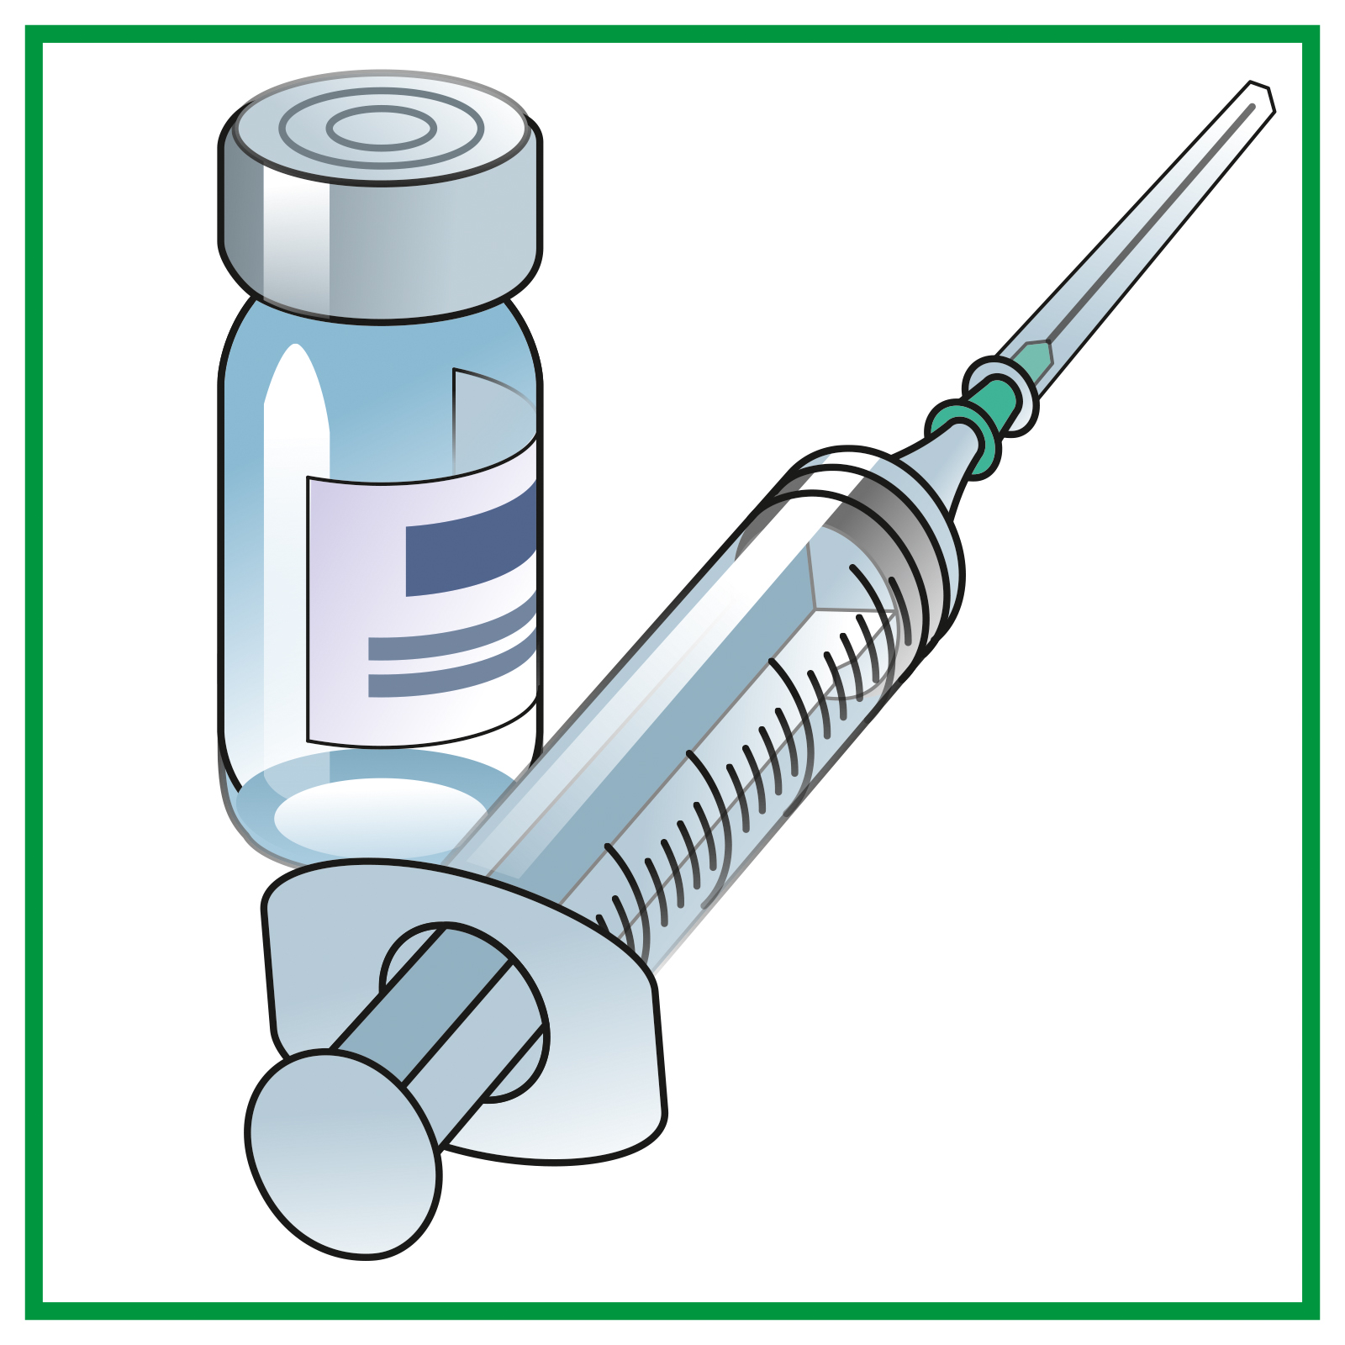
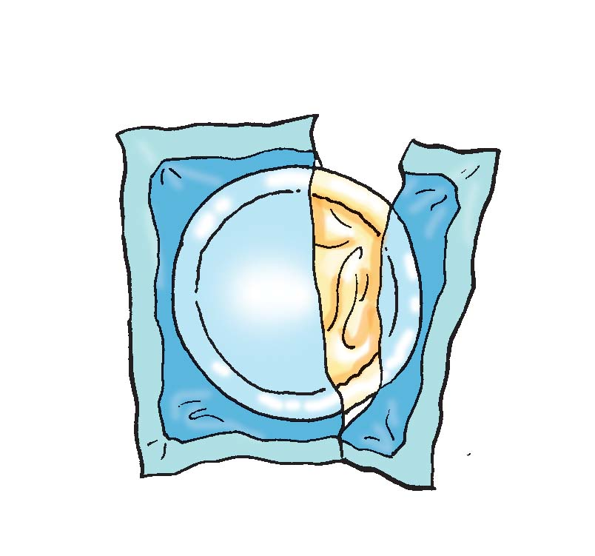
Pregnancy Health
Danger signs
About your body
Staying healthy
Healthy foods
Safe childbirth
Family planning
Notes:
Image source 1. Pixabay
2. Family Planning - Female sterilization - 08 - Non-country specific | IYCF Image Bank (advancingnutrition.org)
3. Download Connect Competition Pregnant Woman Royalty-Free Stock Illustration Image - Pixabay
4. Download Vegetables, Fruits, Food. Royalty-Free Vector Graphic – Pixabay
5. Breastfeeding - Early initiation of breastfeeding 0-6 mo - 02 - India | IYCF Image Bank (advancingnutrition.org)
6. Family Planning - Birth Control - condom - 03 - Nepal | IYCF Image Bank (advancingnutrition.org)
Family Planning - Injectable contraceptives - 03 - Kyrgyz Republic | IYCF Image Bank (advancingnutrition.org)

